Slide 1
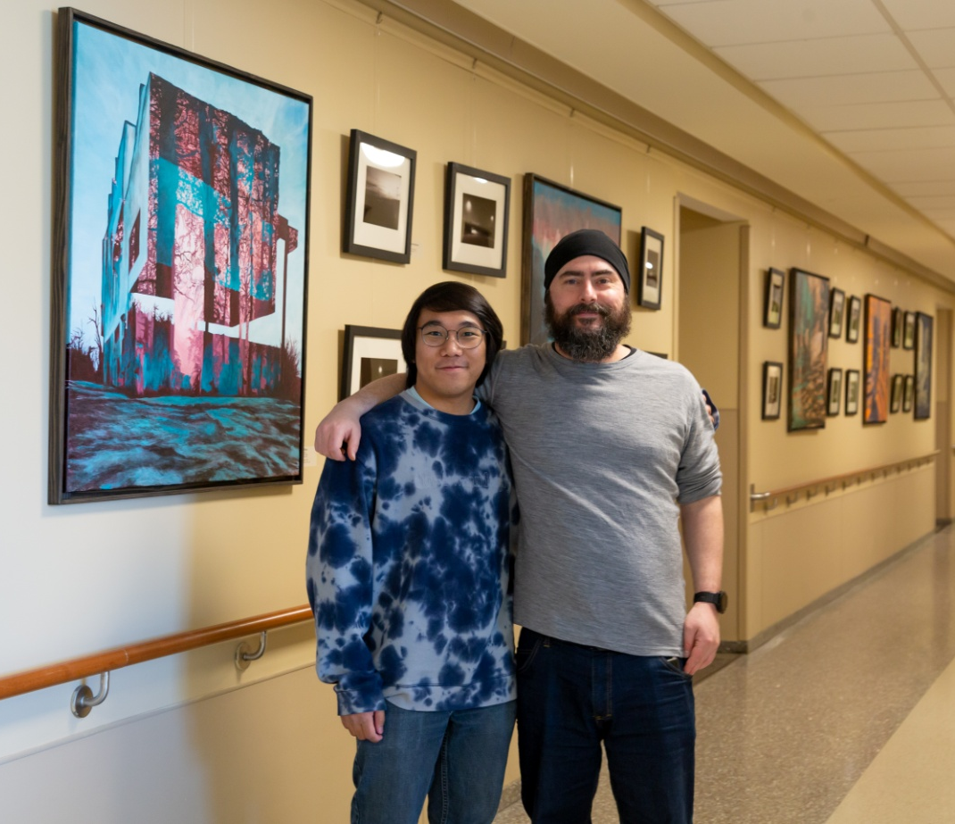
Basilio Daniel Gonzales and Joseph Wimberly
Featured Artists
February 18 to June 30, 2023
University of Maryland Charles Regional Medical Center

Slide 2
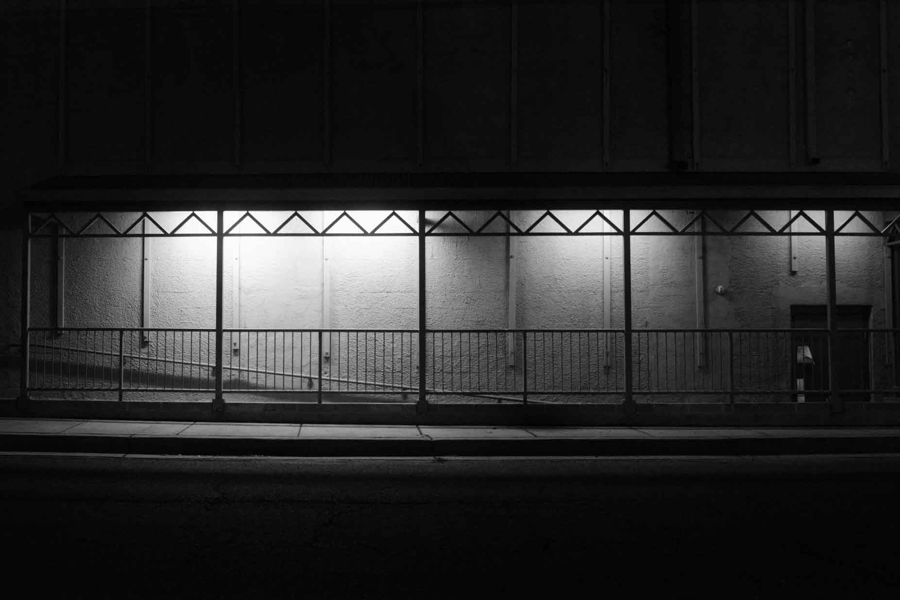
Acting
Daniel Gonzales
Photography
2022
9” x 6”

Slide 3
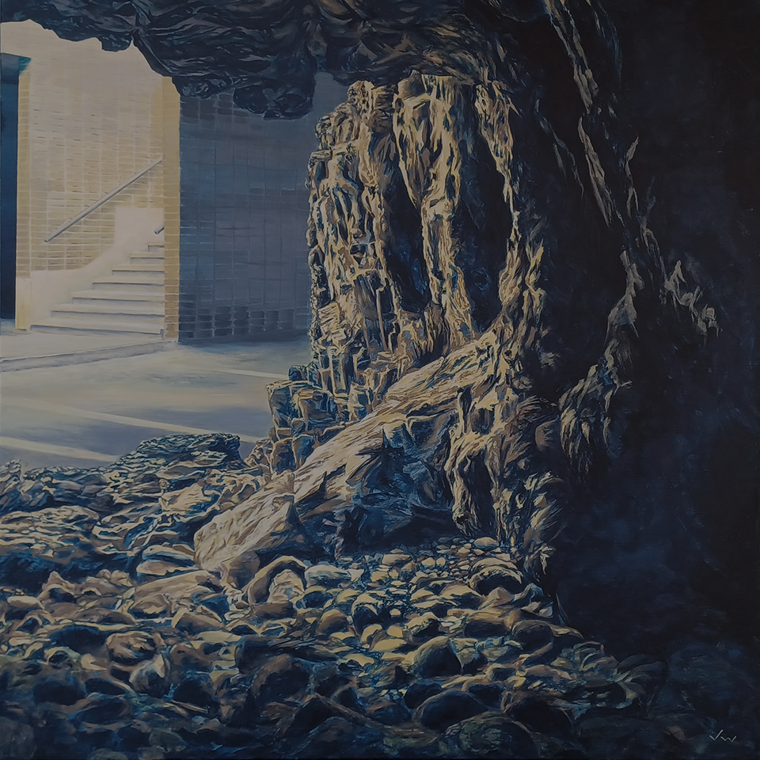
Ascension
Joseph Wimberly
Acrylic on Canvas
2022
36” x 36”

Slide 4
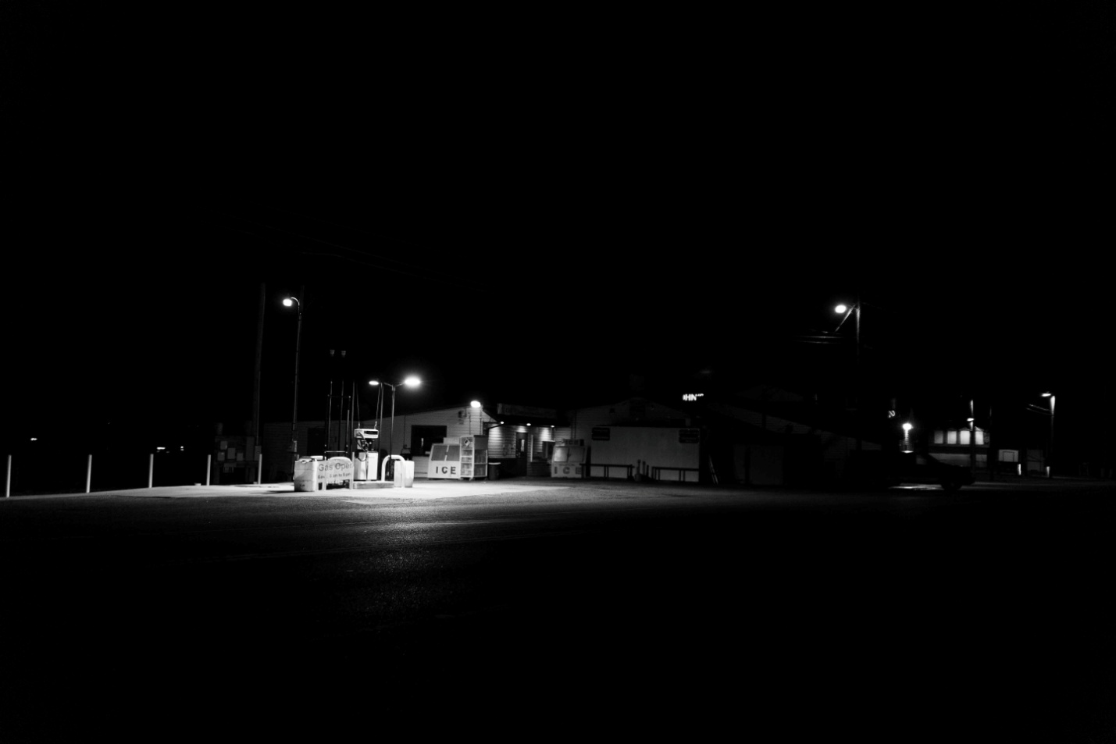
By the Boat
Daniel Gonzales
Photography
2022
9” x 6”

Slide 5
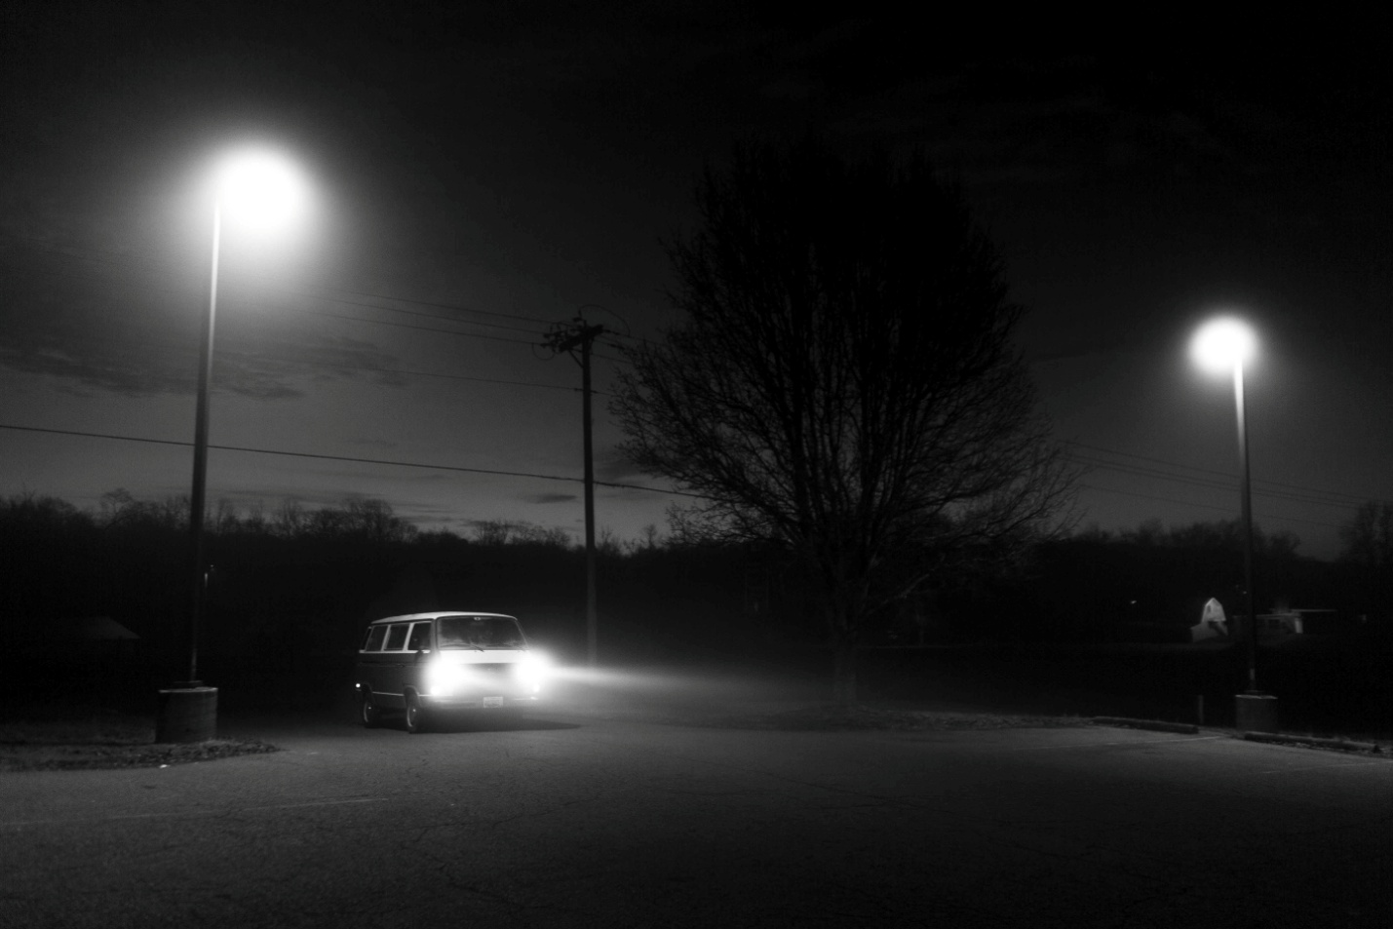
Clements
Daniel Gonzales
Photography
2022
9” x 6”

Slide 6
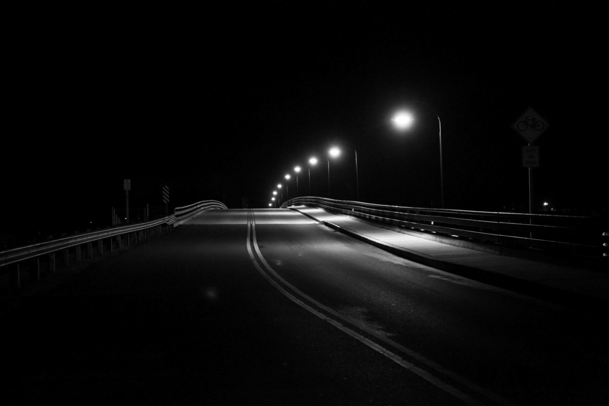
Cobb Island Bridge
Daniel Gonzales
Photography
2022
9” x 6”

Slide 7
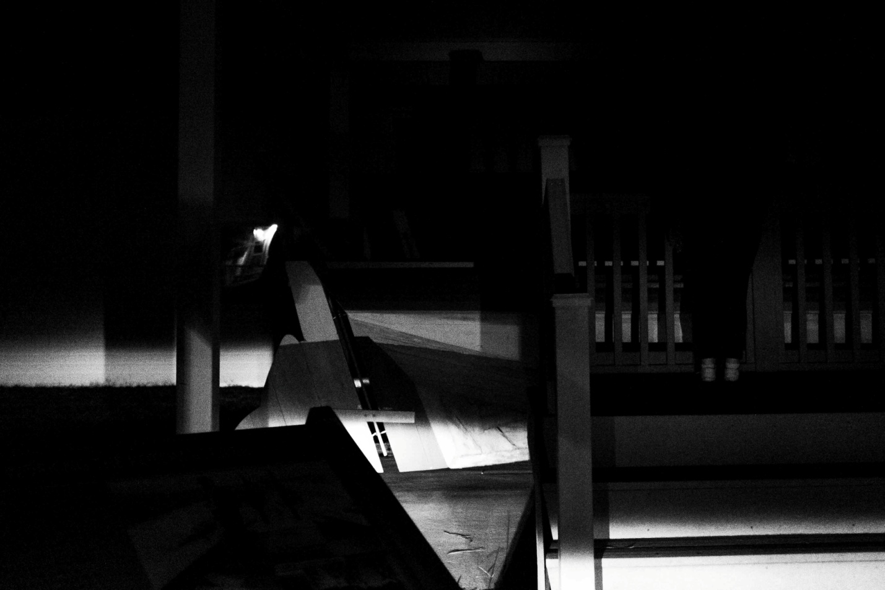
Coyotes
Daniel Gonzales
Photography
2022
9” x 6”

Slide 8
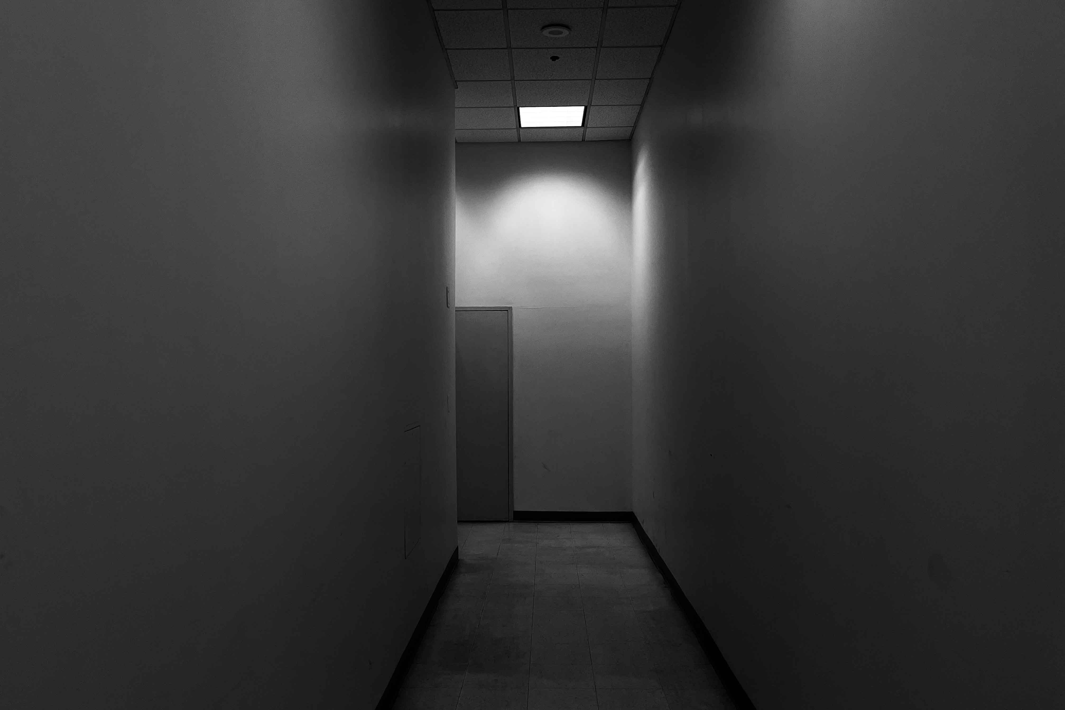
Hallway Out
Daniel Gonzales
Photography
2022
9” x 6”

Slide 9
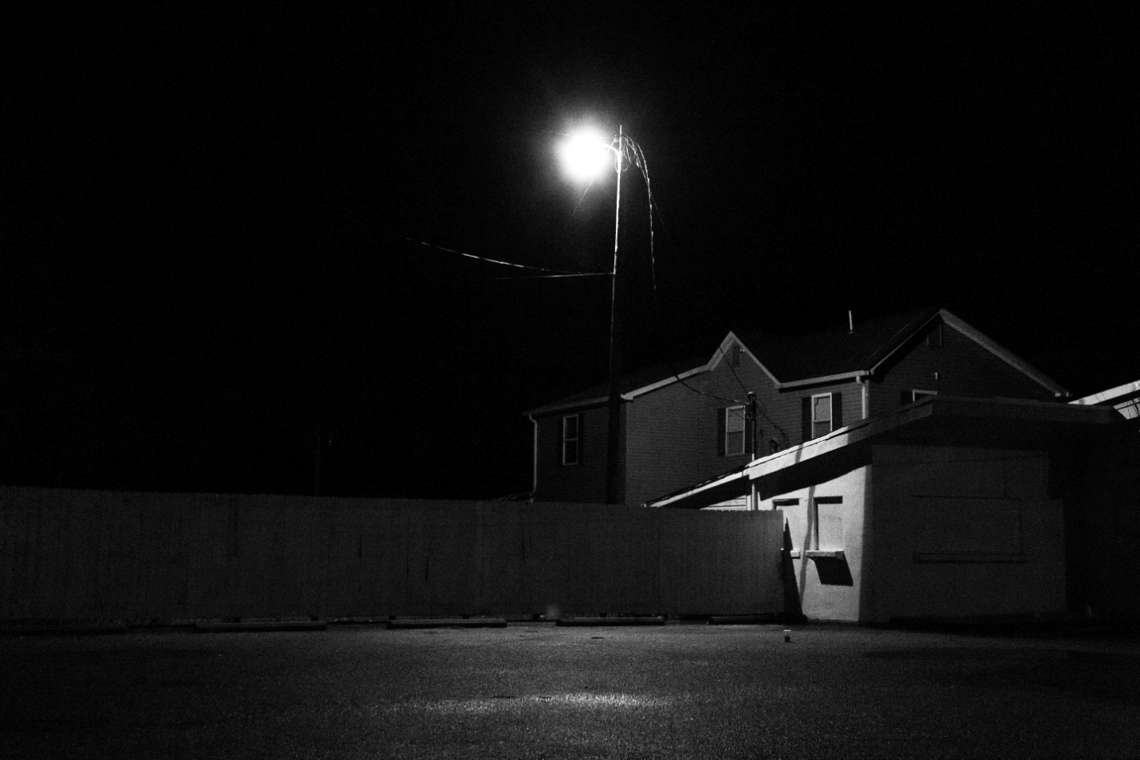
House by Red Top
Daniel Gonzales
Photography
2022
9” x 6”

Slide 10
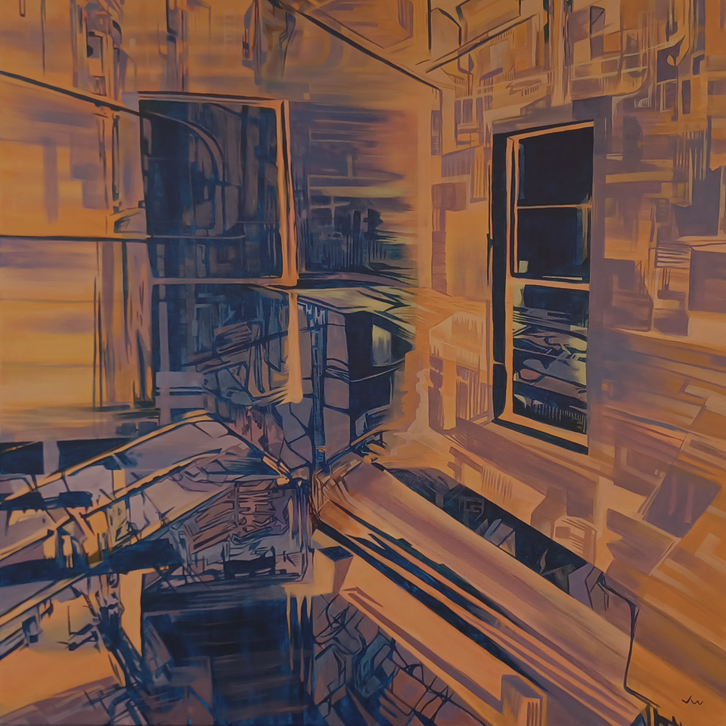
Integrations
Joseph Wimberly
Acrylic on Canvas
2022
36” x 36”

Slide 11
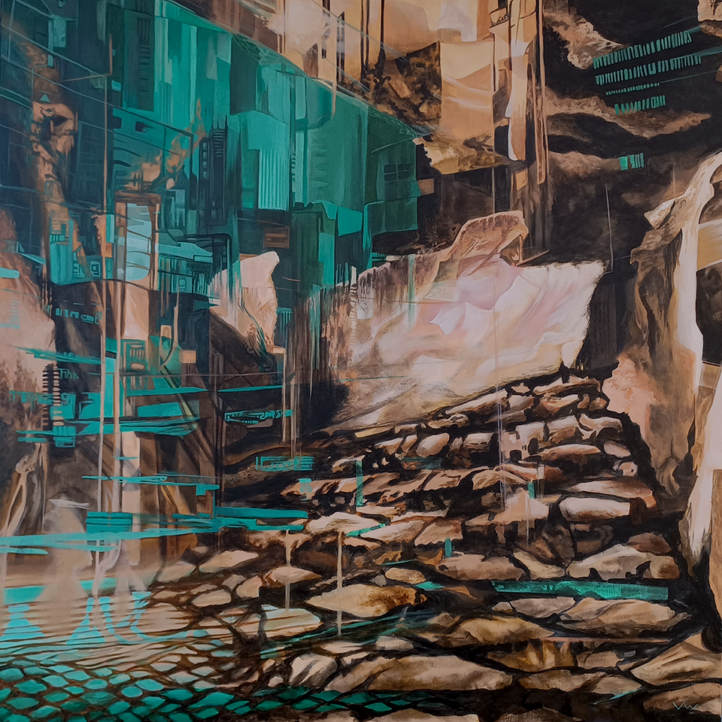
Intersections
Joseph Wimberly
Acrylic on Canvas
2022
36” x 36”

Slide 12
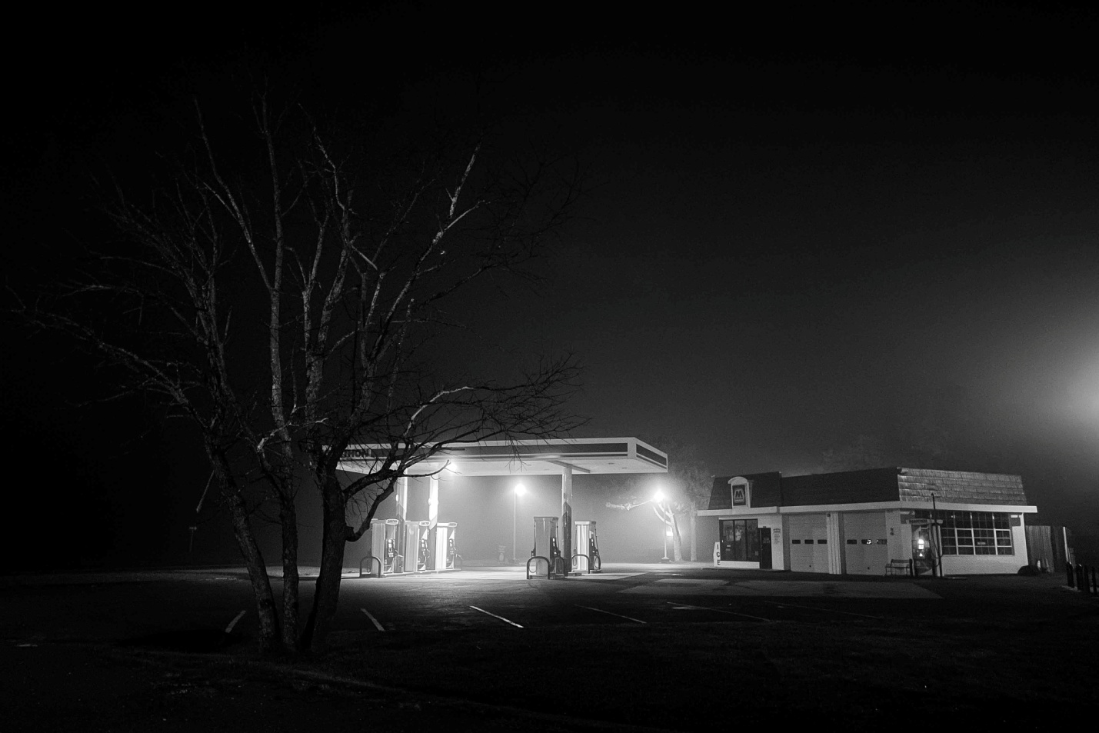
Marathon
Daniel Gonzales
Photography
2022
9” x 6”

Slide 13
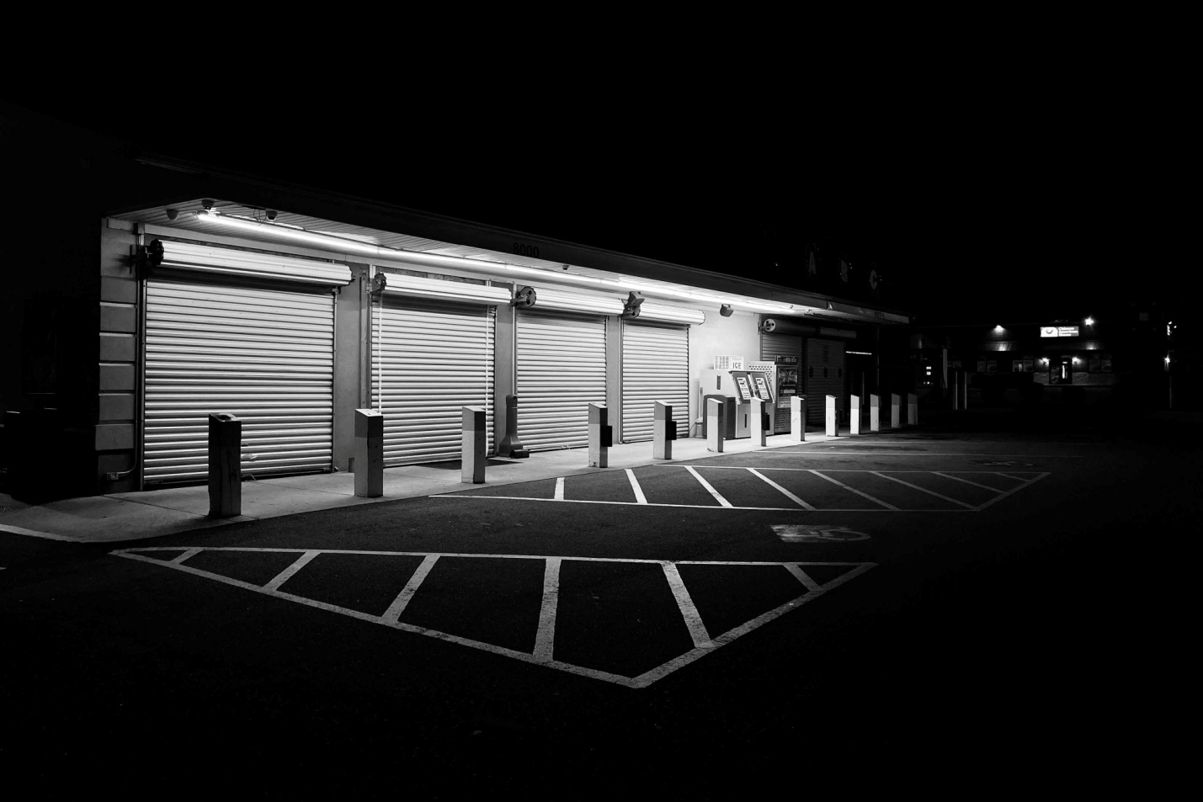
Moving On
Daniel Gonzales
Photography
2022
9” x 6”

Slide 14
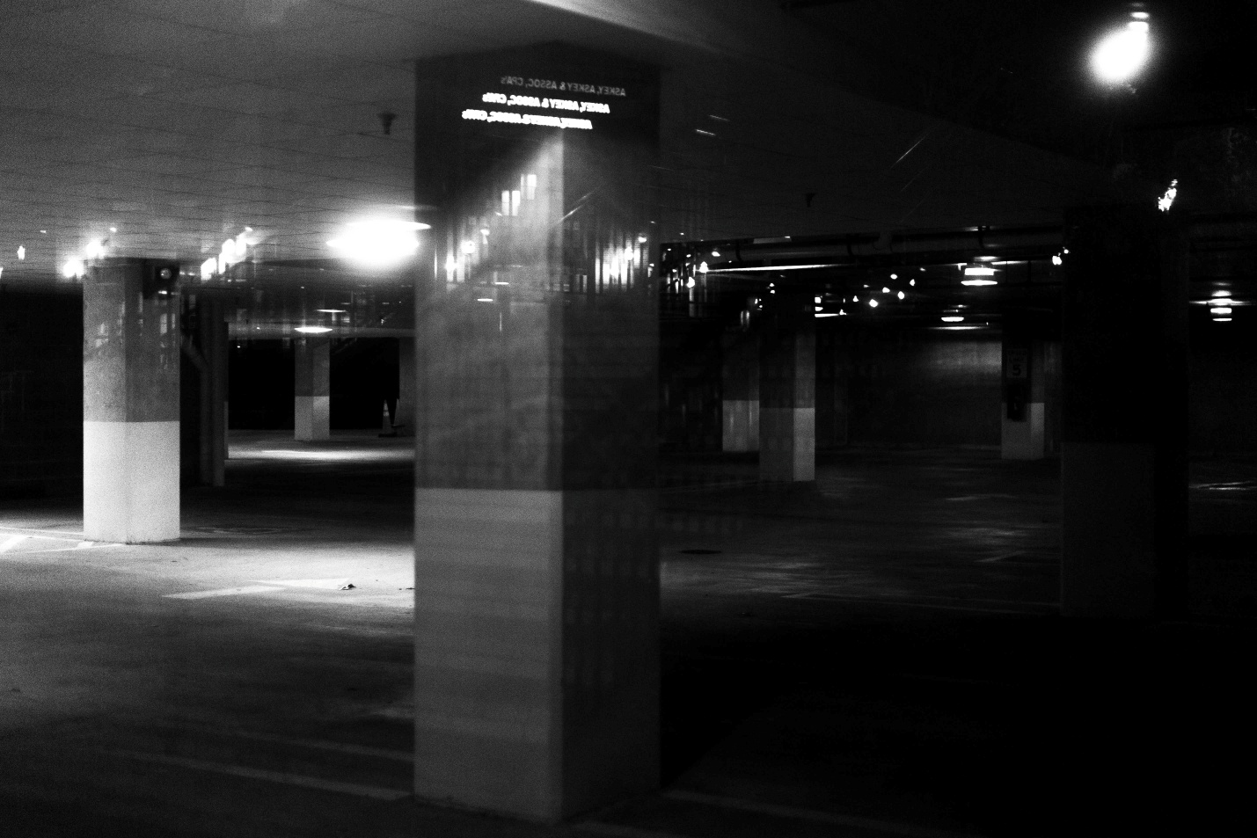
Parked
Daniel Gonzales
Photography
2022
9” x 6”

Slide 15
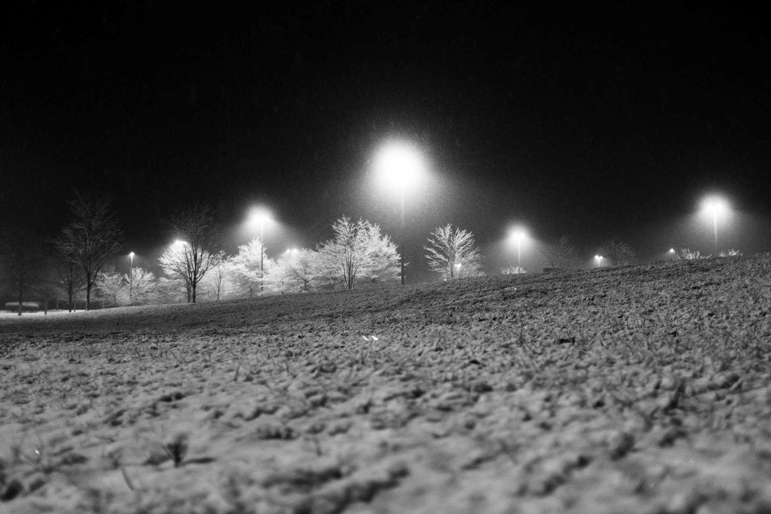
Parking Lot Snow
Daniel Gonzales
Photography
2022
9” x 6”

Slide 16
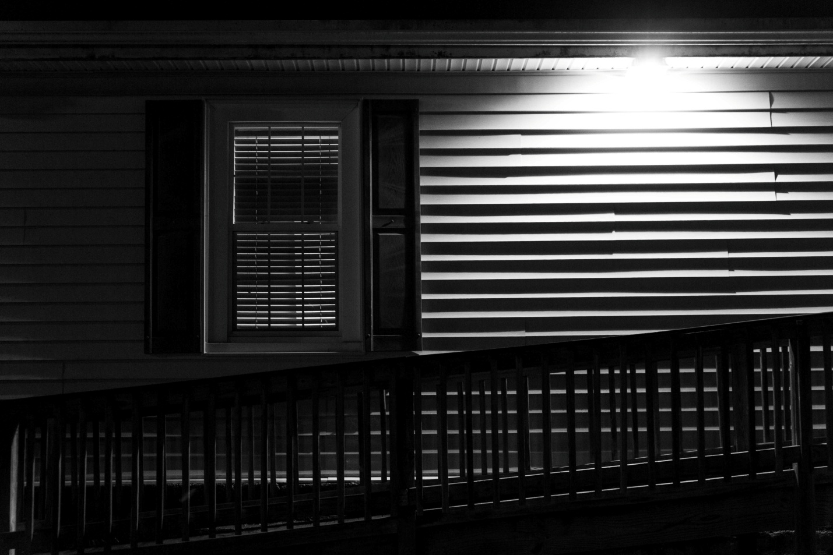
Ramp
Daniel Gonzales
Photography
2022
9” x 6”

Slide 17
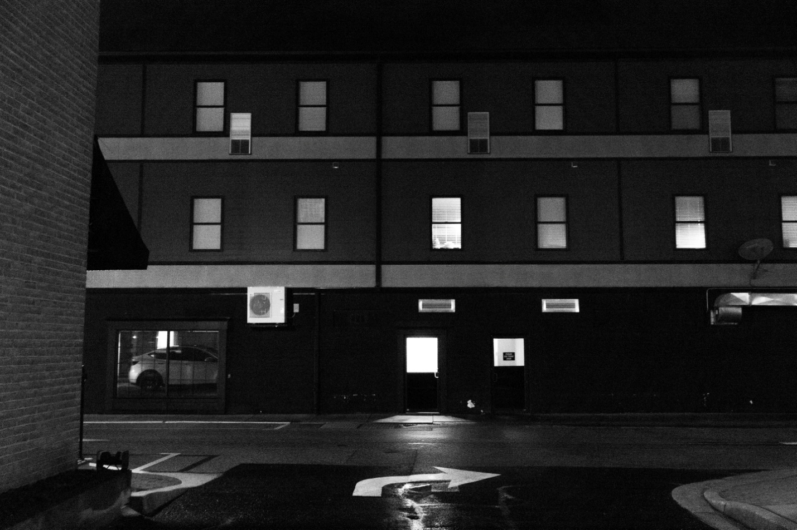
Red Building
Daniel Gonzales
Photography
2022
9” x 6”

Slide 18
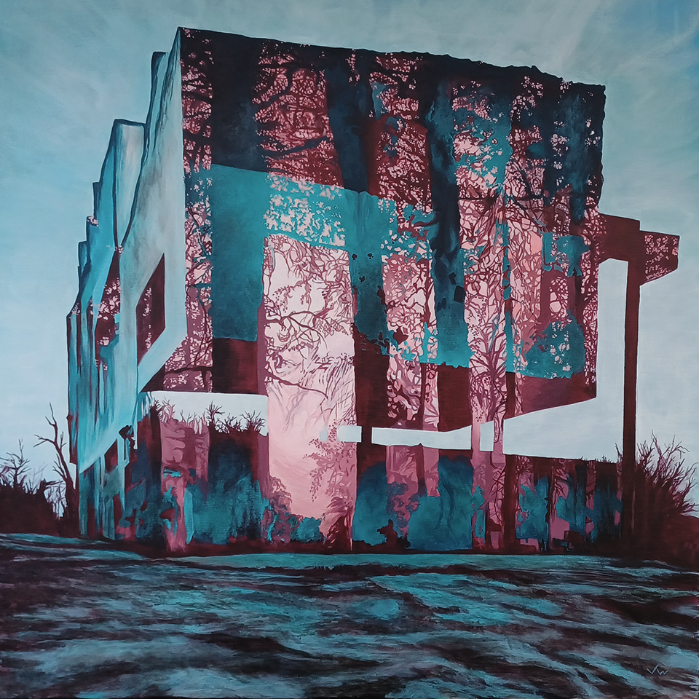
The Artifice
Joseph Wimberly
Acrylic on Canvas
2022
36” x 36”

Slide 19
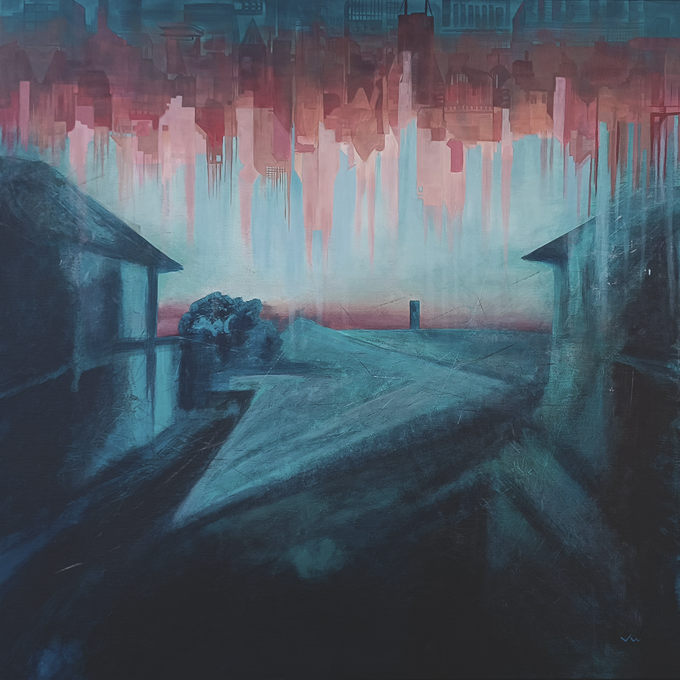
The Next Normal
Joseph Wimberly
Acrylic on Canvas
2022
36” x 36”

Slide 20
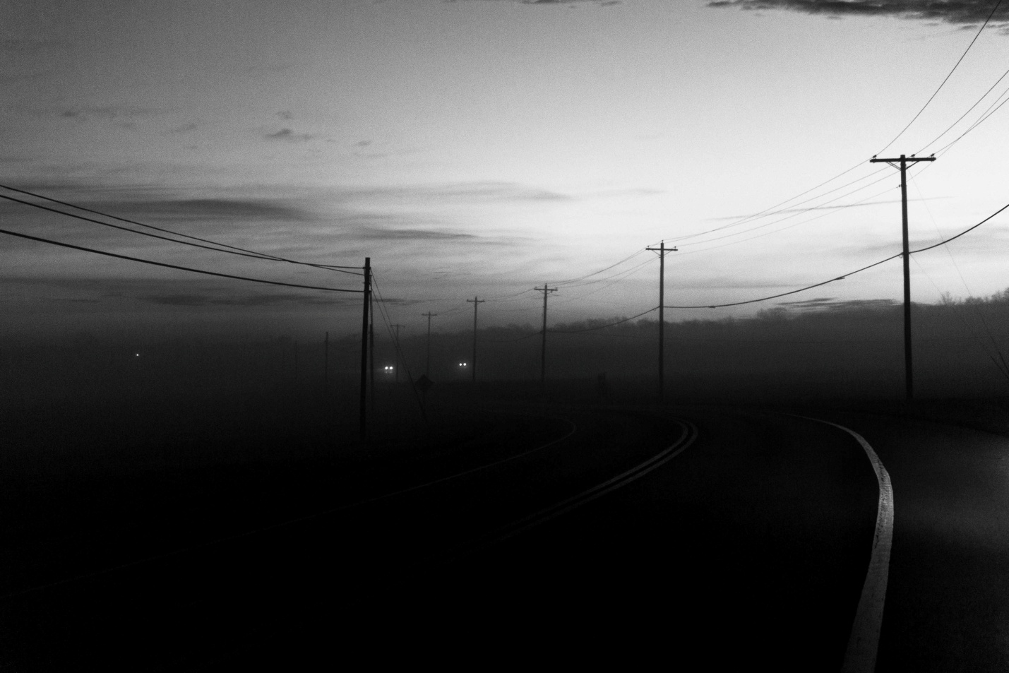
To Leonardtown
Daniel Gonzales
Photography
2022
9” x 6”

Slide 21
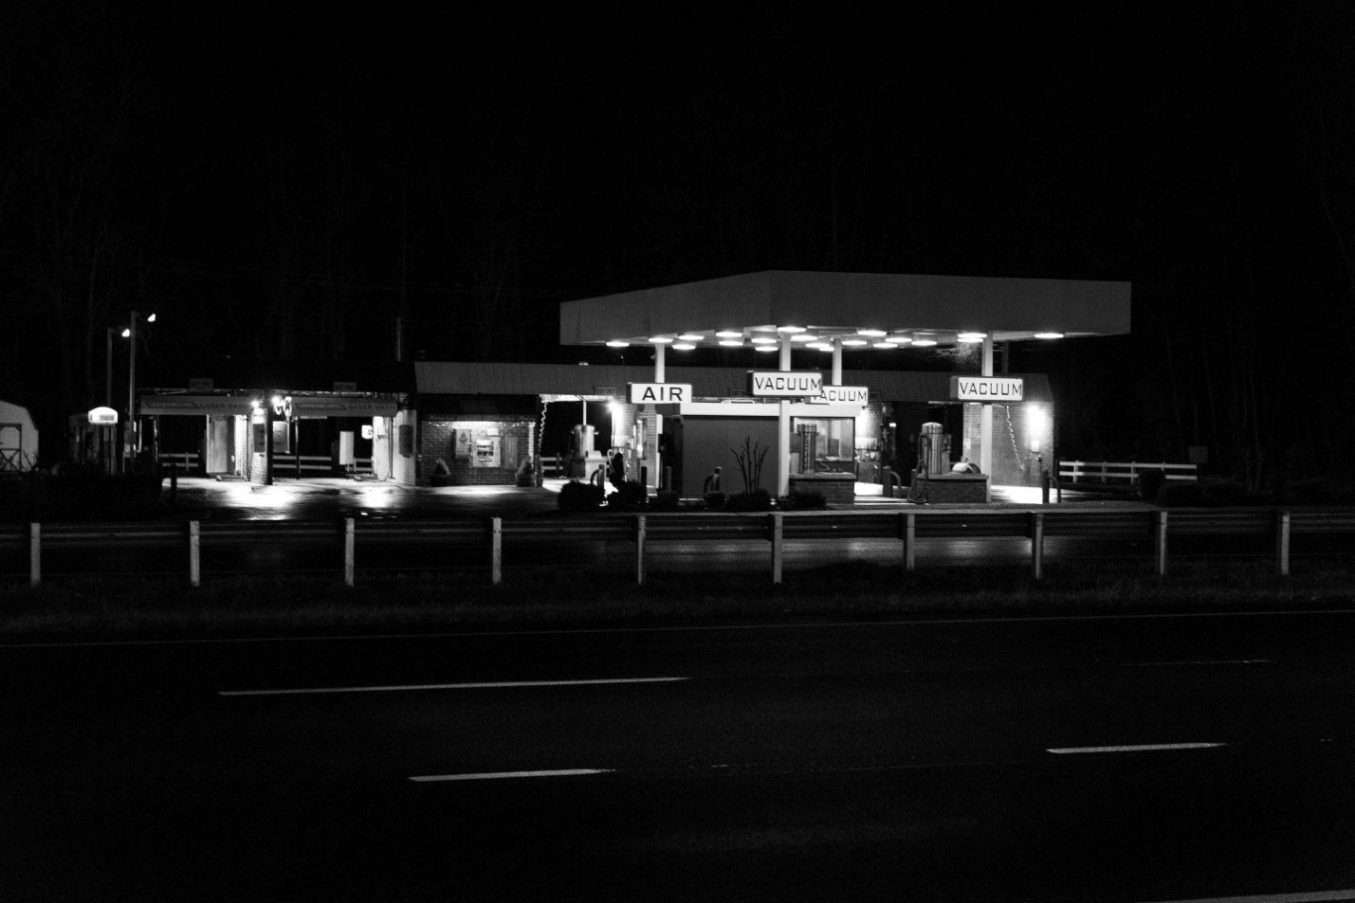
Underlined
Daniel Gonzales
Photography
2022
9” x 6”

Slide 22
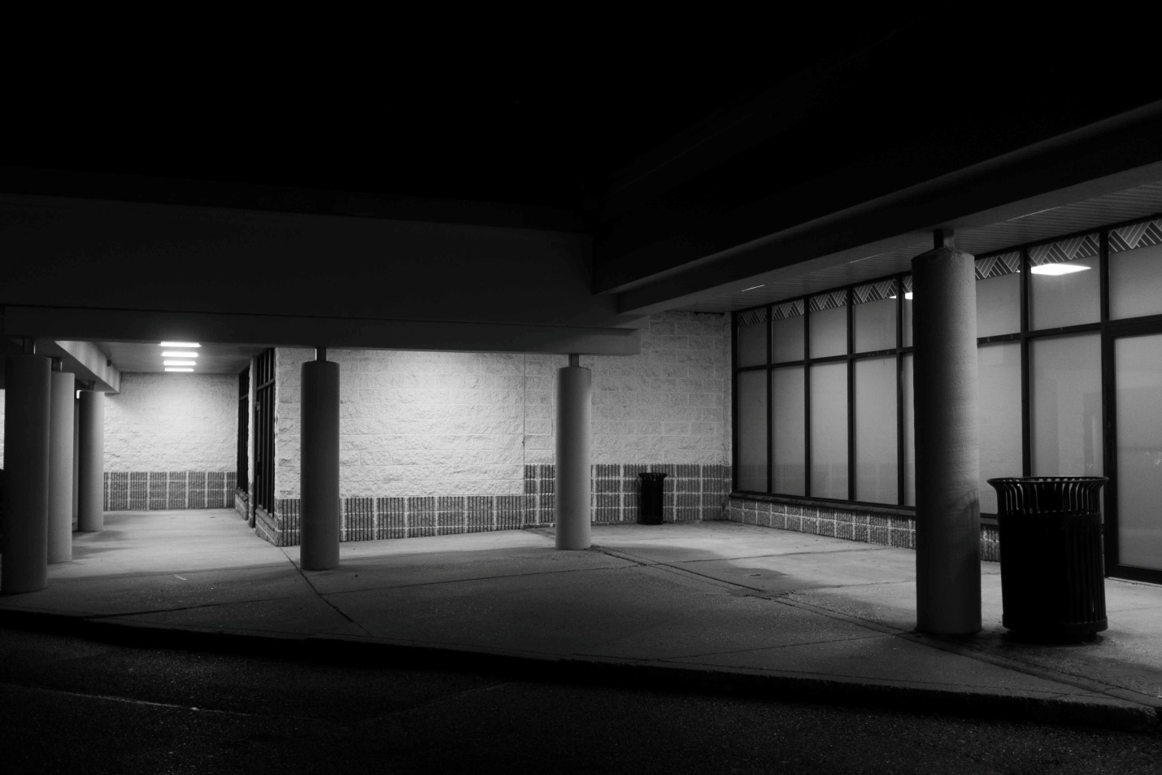
Walkway
Daniel Gonzales
Photography
2022
9” x 6”

